Slide 1

Linux Process Monitoring and Control System
COURSE : OPERATING SYSTEMS AND SYSTEMS PROGRAMMING
COURSE CODE: 25CS2104E
SECTION: 4
BATCH: 14
Branch: CSE
GUIDED BY: soumya ENUKONDA(Assistant professor)
2520030157 - SAI SURENDRANATH PENDYALA
2520030195 - ADA ROHAN
2520030291 - MEDIKONDA RAM RATAN
2026-2027

Slide 2
CONTENTS
Abstract
Introduction
Literature Survey
Existing System
Proposed System
Conclusion
Future Scope

Slide 3
ABSTRACT
Linux Process Monitoring and Control System is a Linux-based systems programming project designed to monitor and control running processes efficiently. The system provides information such as Process ID (PID), process state, CPU usage, memory usage, and other process-related details. It allows users to search, monitor, and control processes through a command-line interface. The project demonstrates important Operating Systems concepts including process management, process states, process identification, signals, process creation, and termination. Linux system interfaces and POSIX mechanisms are used to obtain process information and perform process control operations. The proposed system provides a simple and interactive environment for understanding how Linux manages processes and resources.

Slide 4
INTRODUCTION
Managing and monitoring multiple processes is an important part of Linux Operating Systems and Systems Programming. Each running process has its own Process ID, state, CPU usage, memory usage, and other information that may need to be observed and managed. Understanding this information helps users learn how Linux handles processes and system resources. This project focuses on developing a Linux-based command-line application that allows users to view process information, search for specific processes, monitor process activity, and perform basic process control operations using Linux system interfaces and POSIX mechanisms.

Slide 5
LITERATURE Survey
Linux offers a powerful set of system-level facilities for observing, analyzing, and controlling running processes. A process can be tracked through its Process ID (PID), execution state, resource consumption, and other runtime characteristics. The operating system also provides signals for sending control commands to processes, along with system calls such as fork(), wait(), waitpid(), and kill() for creating processes, handling their completion, and managing their execution. In addition, the /proc virtual file system provides valuable information about active processes and overall system resources. POSIX APIs further support reliable process-management operations. By combining these mechanisms, the proposed Linux Process Monitoring and Control System provides an effective way to monitor process activity, understand system behavior, and perform essential process-control operations through a unified interface.

Slide 6
Existing system
The existing Linux environment provides system utilities that allow users to view information about running processes and perform process-management operations. However, managing multiple processes can be difficult when users need to identify process details, observe process states, monitor resource usage, and control individual processes. Although existing system utilities provide the required process information, understanding the underlying Operating Systems mechanisms is important for Systems Programming. Therefore, there is a need for a simple and interactive system that combines process monitoring, process searching, information display, and basic process-control operations in one command-line application.

Slide 7
Proposed system
The proposed system is a Linux Process Monitoring and Control System developed as a command-line based application using C. It obtains process-related information using Linux system interfaces, particularly the /proc file system and system calls. A menu-driven interface allows users to list running processes and search for specific processes. Users can view process details and monitor CPU and memory usage. The system allows users to control processes using Linux signals. It demonstrates important concepts such as process management, Process IDs (PIDs), process states, signals, system calls, process creation, termination and the /proc file system.

Slide 8
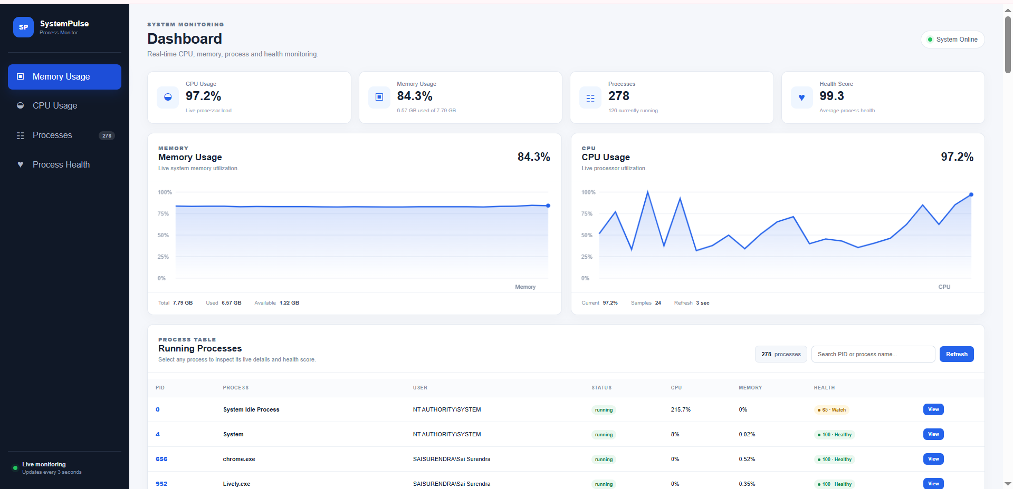
INPUT AND OUTPUT SCREENSHOT - 1

Slide 9
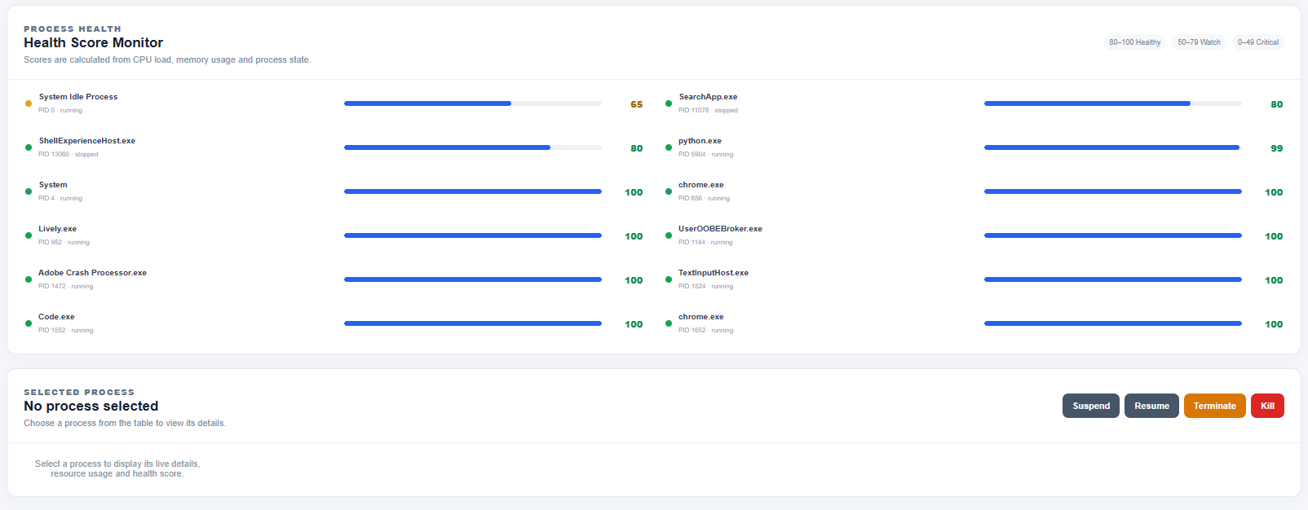
INPUT AND OUTPUT SCREENSHOT - 2

Slide 10
conclusion
The Linux Process Monitoring and Control System provides a functional command-line solution for monitoring and controlling Linux processes. The system allows users to view running processes, search for specific processes, display process information, monitor CPU and memory usage, and perform basic process-control operations. Through this project, important Operating Systems and Systems Programming concepts such as process management, process states, signals, system calls, the /proc file system, and POSIX mechanisms are practically demonstrated. The project provides a simple way to understand how processes are monitored and controlled in a Linux environment.

Slide 11
FUTURE SCOPE
The system can be enhanced in the future by adding more advanced process-monitoring and management features. It can be extended to provide real-time monitoring, graphical visualization of CPU and memory usage, process history and logging, advanced filtering and sorting, and improved process-control options. The system can also be developed with a graphical user interface to make it easier for users to monitor and manage processes. These enhancements can make the application more powerful and useful for Linux system administration and Operating Systems learning.

Slide 12
THANK YOU

